Slide 1
LM 35 Temperature Sensor -ADC
Dr.Sreejith Rajan

Slide 2
ADC
  Digital Value = (V_{is} / A_{ref}) x 1024
  Eg : if V_{is}= 2v and A_{ref}= 5v
  Digital Value = (2/5) x1024
  = 409
  Input signal voltage = V_{is} = (Digital Value X A_{ref} )/1024;
1

Slide 3
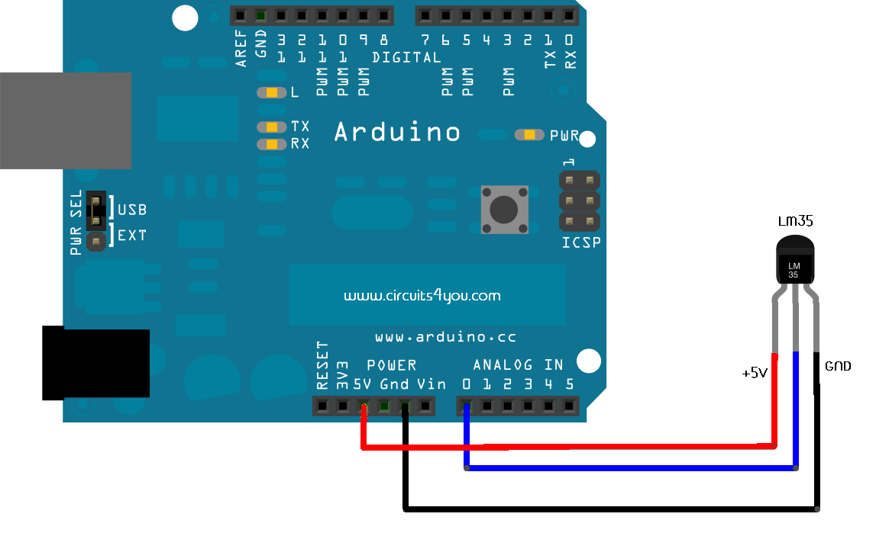
LM 35 Temperature sensor with Arduino

Slide 4
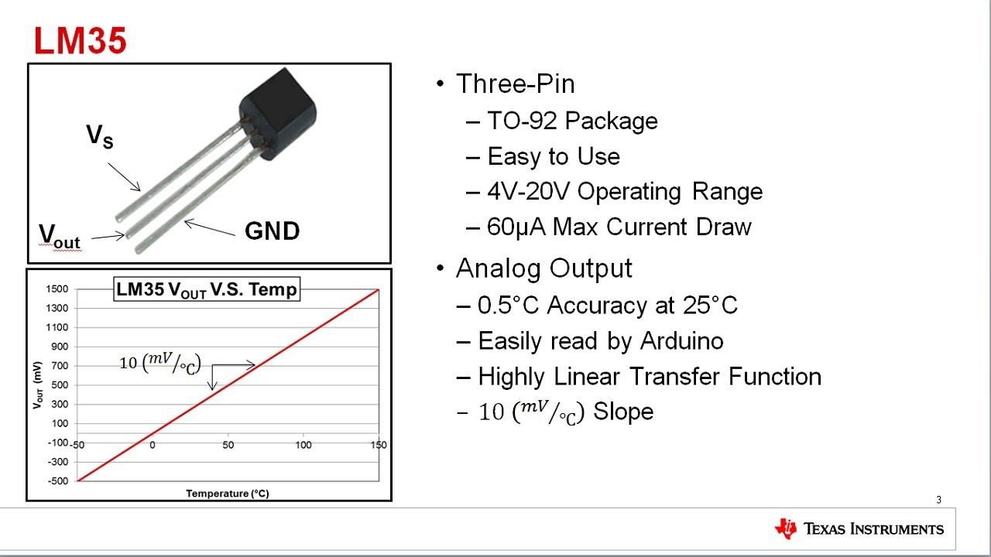
LM 35 Temperature sensor with Arduino

Slide 5
Read Temperature and Display
Use basic math to convert ADC Value to Temperature
Use lcd.h and lcd.c to print temperature in the LCD
  Input signal voltage = V_{is} = (Digital Value X A_{ref} )/1024;
  Temperature = V_{is}/ 10mv
  = Digital Value X [(A_{ref} X 100)/1024]
  = Digital Value X [(5 X 100)/1024]
  = Digital Value X 0.488

Slide 6
THANK YOU

